Slide 1

Strategic Direction

Slide 2

DEFINITION OF ORGANISATIONS
Organisations as defined by profit
Business Firm
Nonprofit Organisation
  Both commonly referred to as
  the Firm
  the Company
  the Corporation
  the Organisation

Slide 3
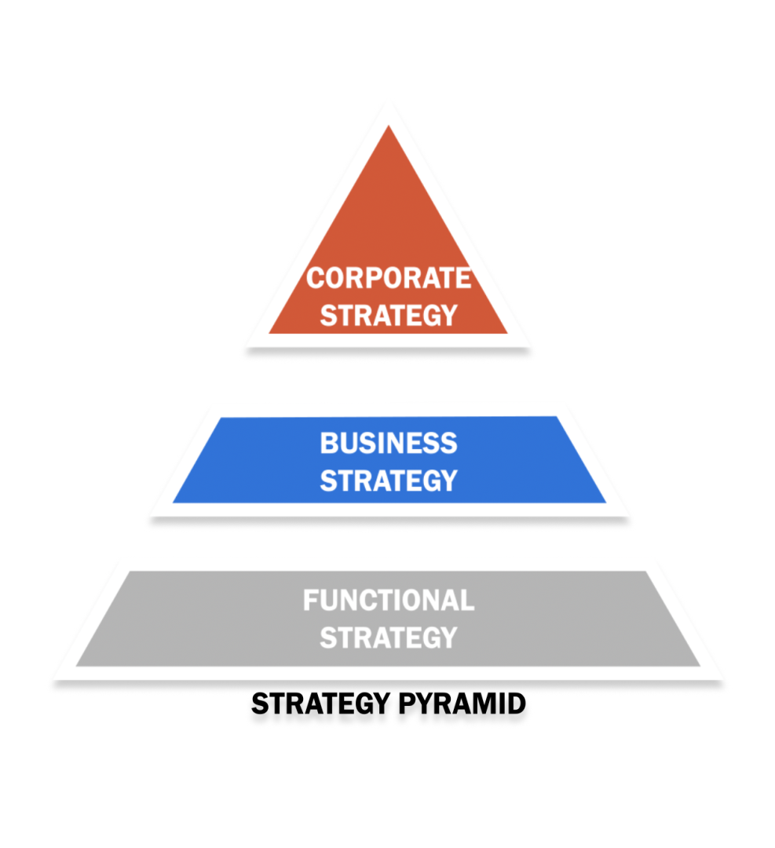
ORGANISATION’S LEVELS OF STRATEGY
Corporate Level-create value for stockholders
Business Unit Level- plan direction for each SBU
Functional Level –execute plan on daily basis
Department-specialised functions of daily operation

Slide 4
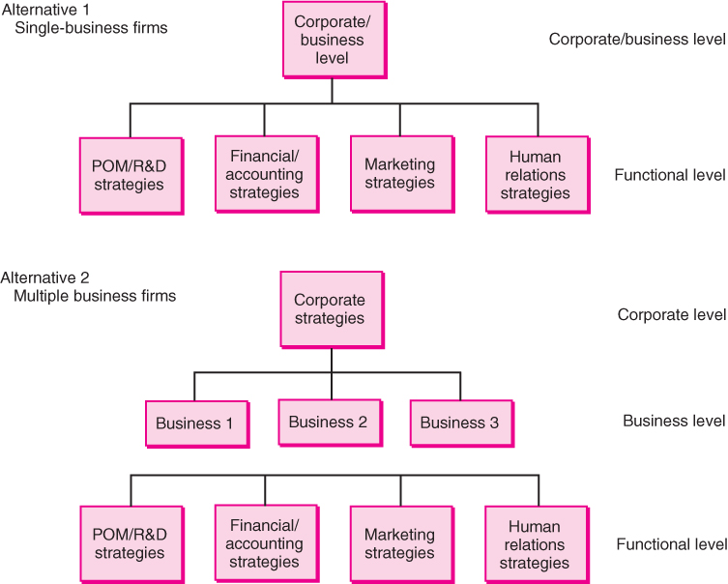
Alternative Strategic Management Structures

Slide 5

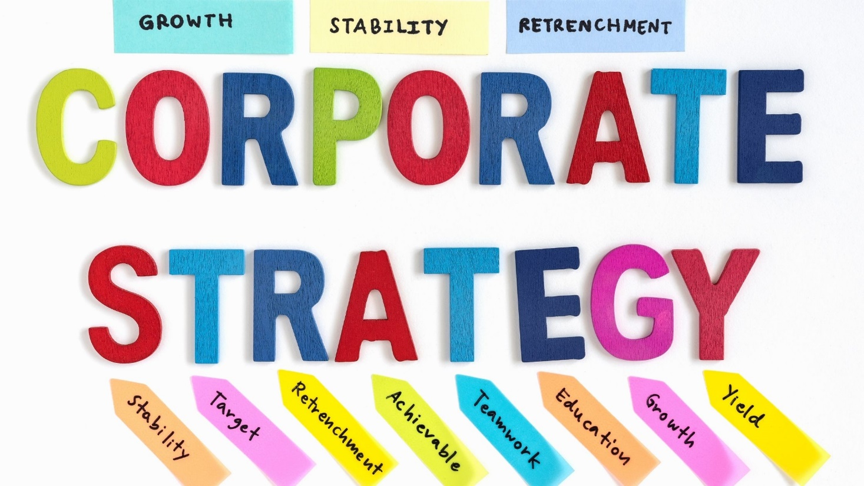
Strategic Management Decisions: Corporate
Domain Definition: Where to Compete?
Defines Scope of Firm
In Which Industries Will We Compete?
Must Be Reflected in Mission
Choice of businesses, entry (diversification) and exit (divestiture) decisions, resource allocation/ priorities for growth
Corporate Financial: Dividend Policies, Sources of Long-term Financing

Slide 6
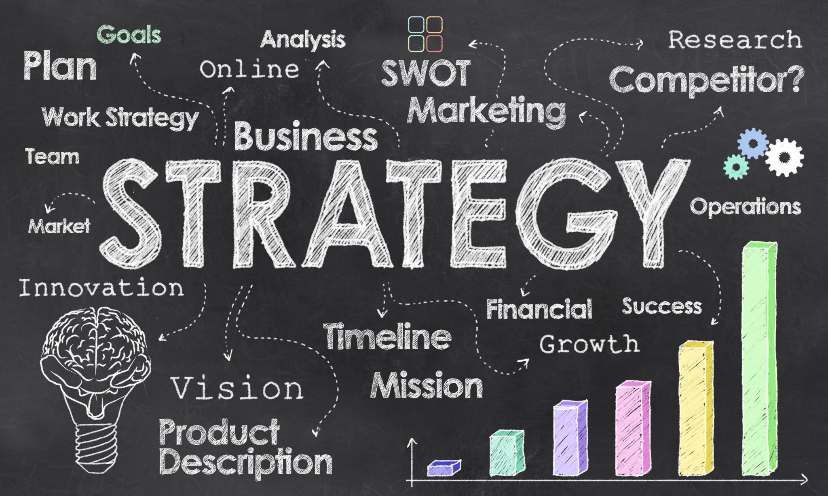
Strategic Management Decisions: Business
Domain Navigation: How to Compete?
Competitive Strategy
Help bridge decisions at the corporate and functional levels
Less costly, risky, and potentially profitable than corporate-level decisions
More costly, risky, and potentially profitable than functional-level decisions
Include decisions on plant location, marketing segmentation, and distribution

Slide 7

Strategic Management Decisions: Functional
Implement the overall strategy formulated at the corporate and business levels
AKA Tactics
Involve specific action-oriented and operational issues
Relatively short range (typically within the coming year) and low risk
Modest costs: depend upon available resources
Relatively concrete and quantifiable

Slide 8

FOCUS OF THE STRATEGY
  Mission - statement of the organisation’s purpose for existing, often identifying its customers, markets, products, technology, and values.
Goals or Objectives
Profit
Customer Satisfaction
Sales
Employee Welfare
Market Share
Social Responsibility
Quality

Slide 9

SETTING STRATEGIC DIRECTIONS
A Look Around: Where Are We Now?
Identify your Customers
Competencies-identify what you do best
Competitive Advantage-your unique strength
Competitors-identify the biggest threats

Slide 10
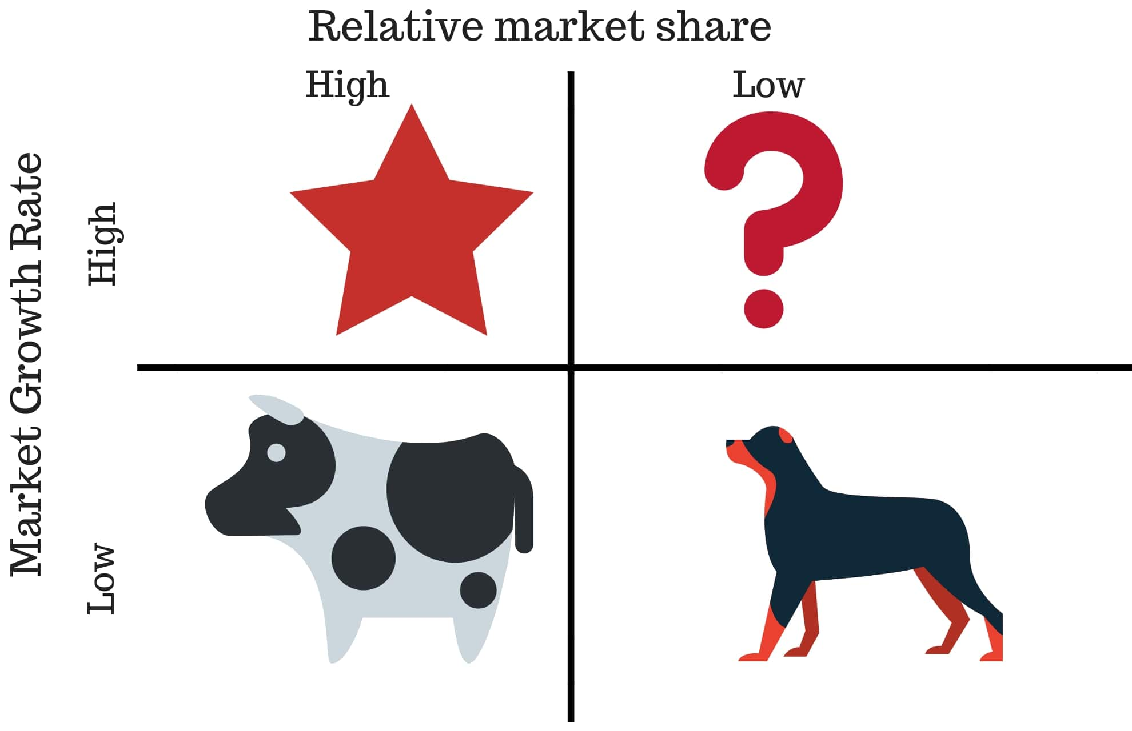
Business Portfolio Analysis (BCG Matrix)
- Where are we now?

Slide 11
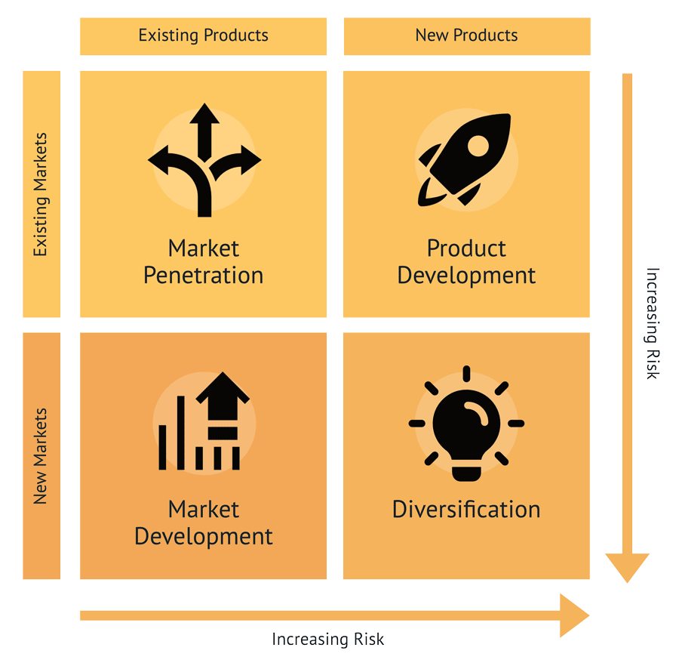
SETTING STRATEGIC DIRECTIONS
Growth Strategies: How Do We Get There?
Market-Product Analysis

Slide 12
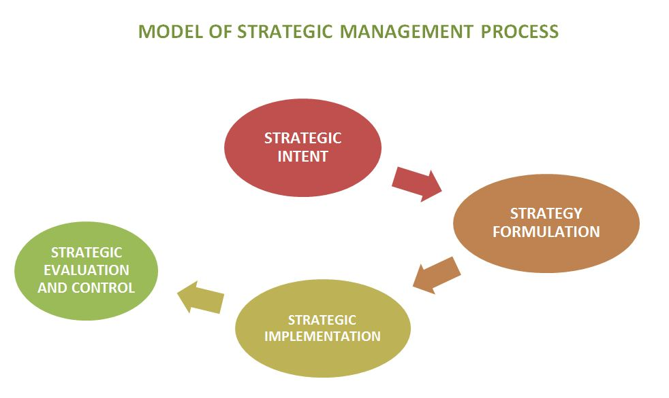
Strategic Management Process
Businesses vary in formulation and other processes
The basic components of the models used to analyse strategic management are similar
Strategic management is a process—a flow of information through interrelated stages of analysis toward the achievement of some goal

Slide 13
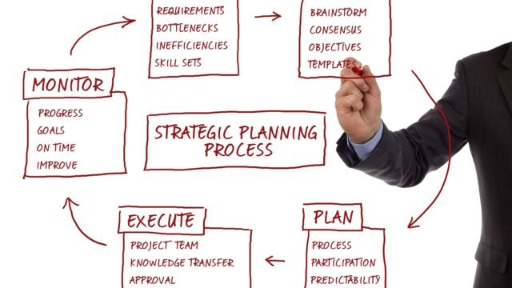
Phases of Strategic Management Process
Formulation
Implementation
Control

Slide 14
Components of Strategic
Management Model
Company Mission
External Analysis
Long-Term Objectives
Short-Term Objectives
Policies Empowering Action
Strategic Control & Continuous Improvement
Internal Analysis
Strategic Analysis & Choice
Generic & Grand Strategies
Functional Tactics
Restructuring, Reengineering & Refocusing

